Slide 1
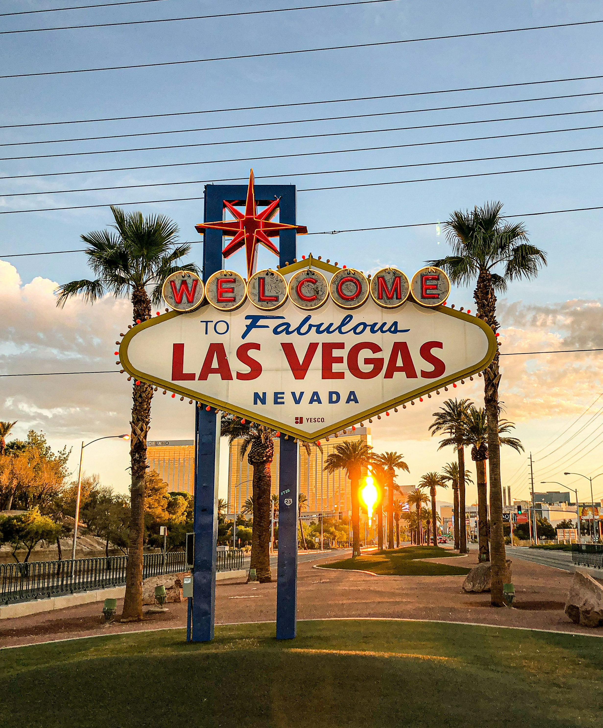


The
All-American
Choose from a selection of amazing resorts spread across the country. Escape to the landscapes and landmarks that make America unique.
4-7 Night Stay for 2 guests
Your choice of destination
online booking portal
Example destinations*: Las Vegas, Branson, Orlando, Myrtle Beach, Park City, Pigeon Forge, Gatlinburg, Williamsburg, Cocoa Beach, New York City, & More!
*Based on availability
Notes:
Details for Presenter:
This is a certificate experience. The winner will receive their certificate by email with instructions on how to redeem online or by phone. Redeemer will have a selection of resorts across the U.S.A. to choose from, and all destinations are subject to availability.
Must be 21+ years of age to win and redeem. No group bookings. No more than 2 certificates per winner and they cannot be combined into a group booking. Winner is responsible for all taxes and resort fees. Airfare, travel to and from resort, tips and gratuity, and anything other than accommodations is not included. Certificate is valid for 2 guests, additional guests including children may incur additional charges. Upgrade options are available when booking. Does not include meals, food, or drink.
12 months to activate and 12 months to book thereafter.
Full terms and conditions are available at https://experienceterms.com/the-all-american/ and on the certificate.

