Slide 1
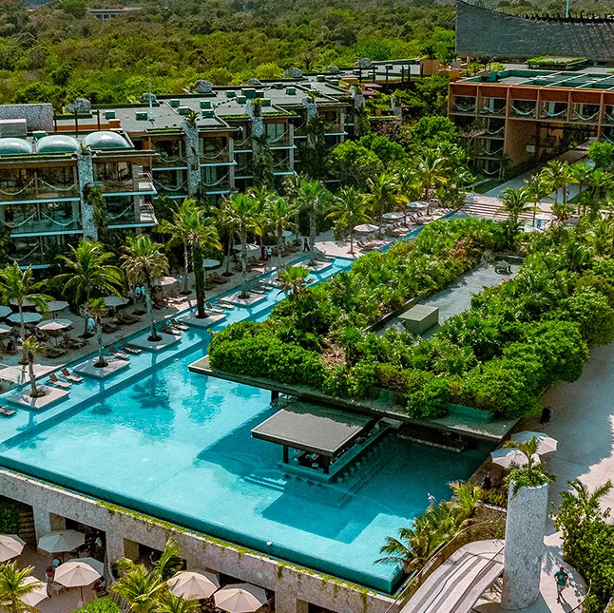
4-Night
Xcaret
All-Inclusive Mexico Vacation for 2
Select Xcaret Locations

Slide 2

The All-Fun Inclusive Vacation
Enjoy a luxurious 5-day, 4-night resort stay for two at your choice of select Xcaret Mexico destinations: Hotel Xcaret México or Hotel Xcaret Arte. This all-inclusive getaway covers all resort fees, offering you and your guest a seamless, worry-free experience. Immerse yourself in the beauty of Mexico with world-class amenities, dining, and activities—all included in your stay at these stunning properties. Perfect for a romantic escape or a memorable adventure, this package promises an unforgettable blend of relaxation and excitement.

Slide 3
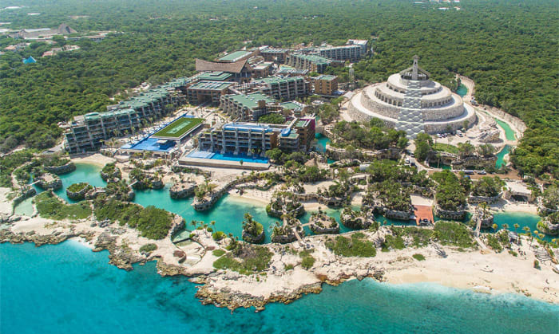
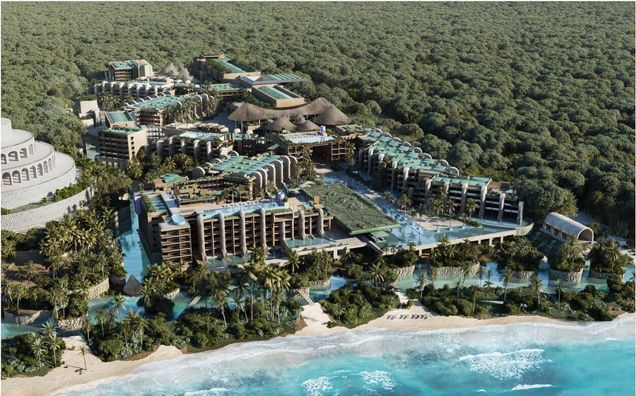
Your Choice of 2 Beautiful Playa Del Carmen Xcaret Resorts
Hotel Xcaret México
Hotel Xcaret Arte – Adults Only
Hotel Xcaret Mexico is a luxurious, all-inclusive resort in Playa del Carmen and Riviera Maya that offers a unique experience blending nature, culture, and adventure with access to Grupo Xcaret's parks.
Hotel Xcaret Arte is a hotel experience in front of the Caribbean Sea, that makes hospitality a sensitive proof of the artistic wealth and sustainability in Mexico. Adults 16+ Only.

Slide 4

4-Night
Xcaret
All-Inclusive Mexico Vacation for 2
5-Day / 4-Night Accommodations
All-Inclusive Stay
Select Xcaret Mexico Locations
2 Guests (Must be 30+ to Book)
  Additional Guests and Upgrades Not Available
Blackout Dates Apply
Must book a Minimum of 8 Months in Advance of Travel

